Slide 1



02.a Accessing CLI using Desktop
After completing this section, you should be able to log in to the Linux system using the GNOME 3
desktop environment to run commands from a shell prompt in a terminal program.

Slide 2

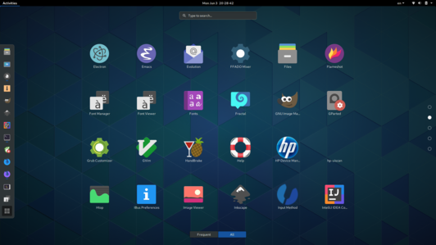
GUI
Graphical Interface

